Slide 1
Automated Image Caption Generator
MINOR PROJECT (Panel – 06)

Slide 2
Project Group Members Bhavya Tyagi (181B070) Bhawana Mishra (181B071) Chandan Kumar (181B074) Project Mentor Mr. K.B. Meena

Slide 3
Introduction (Automated Image Caption Generator)
Idea: AI problem to generate text (caption) for a picture.
Motivation: Importance of the model w.r.t real world scenarios. 1. Make Google Image Search easy: As every image would first be converted into a caption and then search can be performed based on it. 2. Aid to the blind: A product for the blind which will guide them travelling on the roads without the support of anyone else.

Slide 4
Related Works
Skin Vision: ‘Rule-based’ system, reliable in recognizing dangerous skin lesions. Accuracy rate is matched with Dermatologists' indication.
Facebook: Preventing Suicide: FB uses AI to track the context of posts, understand what is a suicidal pattern and what isn’t and thus raise Flags.
Google Photos: Classifies photos into mountains, sea etc. Facial Recognition to identify people in a group picture.

Slide 5
Feasibility Study
This model will be feasible within some clicks.
A small dataset of images and vocabulary will be used.
Limitation: The model will depend on the data, so, it can not predict the words that are out of the scope of its vocabulary.
Usage of Dataset This is an optimization that will make training our models faster and consume less memory.
New Caption Generation Later, Tokenizer can be used without having to load the entire training dataset of annotations.

Slide 6
Requirement Analysis
Software Requirements: Python 3, NumPy (v1.19.0), Keras (v2.4.3), Pickle
Hardware Requirements: 1. OS: Windows 7 and above Recommended: Windows 10 2. CPU: 1.60 GHz processor and above 3. Disk Storage: 8GB of free disk space 4. Architecture: 64-bit
For Execution: Jupyter Notebook using Anaconda Framework in Python

Slide 7
Proposed Method
The model requires: 1. Methods from Computer Vision (to understand the content of image) 2. Language model from NLP (to turn the understanding of image into words) 3. After training the model, its learning will be tested using Deep Learning.
Building Process 1. Preparing photo & text dataset 2. Developing deep learning model 3. Training with progressive loading 4. Evaluating model 5. Generating new captions

Slide 8
Proposed Method
Development of DL model It has 3 steps: Loading, Defining and Fitting the model.
Implementation of the system: 1. Object Detection: Objects are detected from the image with the help of CNN Encoder, which then is used as input for RNN-LSTM algorithm. 2. Tokenization: Encoded data is mapped from words to unique integer values using Tokenizer. 3. Text Prediction: Using LSTM embedding layer, each predicted word is employed to get subsequent words.

Slide 9
Important Visualizations
Prepare Photo Data
Prepare Text Data
Loading Data
Defining the Model
Fitting the Model
Evaluating the Model
Downloading image dataset (Flicker8k images)
Downloading text data (description of the images, Flicker8k text)
Loading image dataset
Loading text dataset
Sequence Processor (LSTM)
Merging
Photo Feature Extractor (VGG16)
Figure-1: Block Chart of Proposed Model

Slide 10
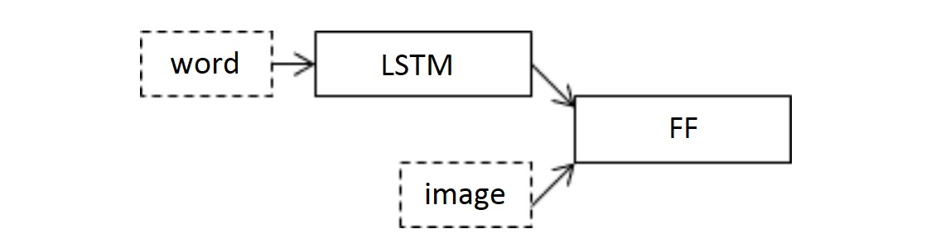
Important Visualizations
Figure-2: where; LSTM: Long-Short term memory & FF: Final feature
(used from Link Reference-06)

Slide 11
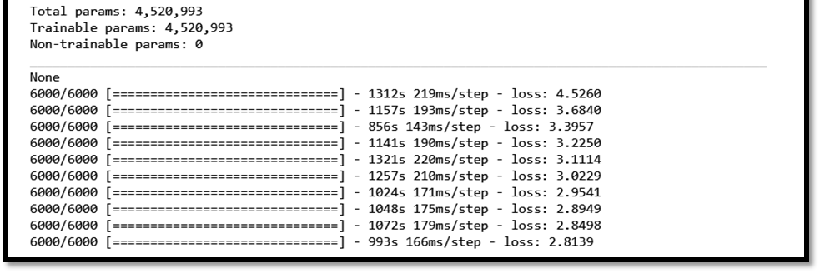
Important Visualizations
Figure-3: Screenshot of training the model for epoch=10 with loss reduced from 4.52 to 2.83

Slide 12
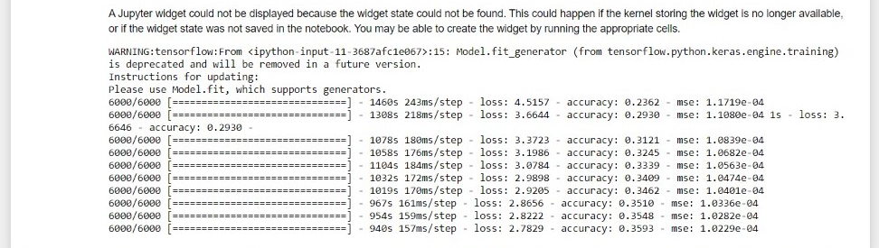
Important Visualizations
Figure-4: Accuracy and Training of the model

Slide 13
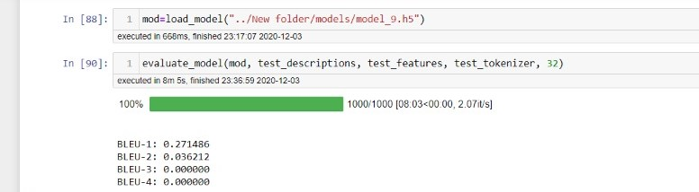
Important Visualizations
Figure-5: BLEU Score of the model

Slide 14
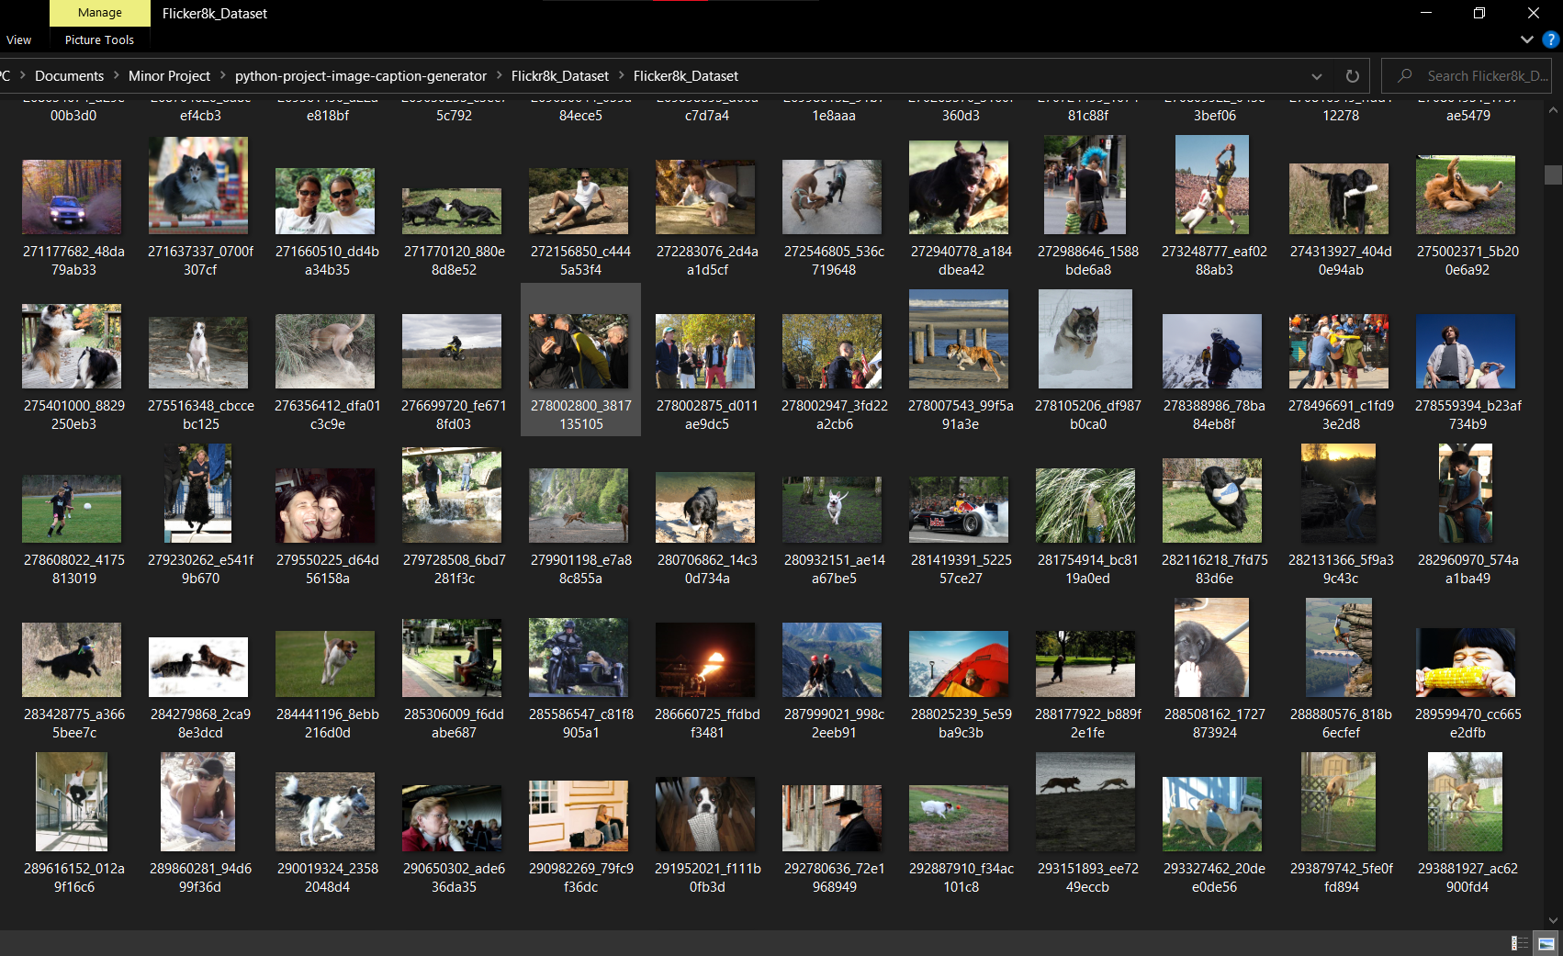
Screenshots
Figure-6: Screenshot of Image Dataset (Flicker_8k)

Slide 15
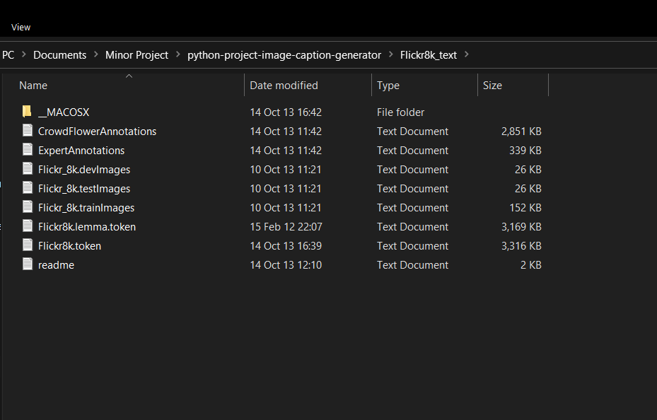
Screenshots
Figure-7: Screenshot of Text Dataset (Flicker_8k)

Slide 16
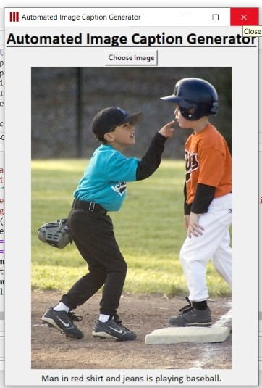
Results
Figure-8: Sample Test Case-1

Slide 17
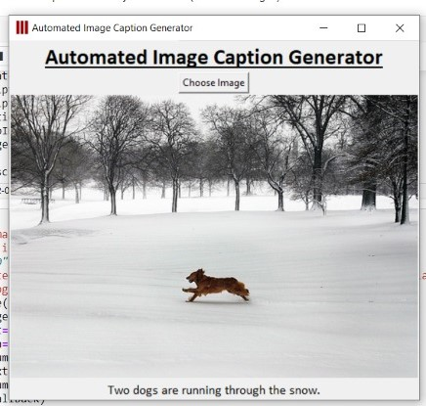
Results
Figure-9: Sample Test Case-2

Slide 18
Conclusion
Goal: System which can automatically generate the description of an image.
Underlying concept: CNN-LSTM based Model
Model’s behaviour & Accuracy: Gives expected results majorly when tested on several images. Accuracy: 35.93% (few images are not well recognized)
Future Scope: Usage of better dataset

Slide 19
References
Machine learning Handouts of College
https://en.wikipedia.org/
https://www.appliedaicourse.com/
https://www.aclweb.org/anthology/L18-1273.pdf
https://www.youtube.com/watch?v=yk6XDFm3J2c
https://www.irjet.net/archives/V7/i4/IRJET-V7I41167.pdf
https://www.kaggle.com/wikiabhi/image-caption-generator
https://machinelearningmastery.com/develop-a-deep-learning-caption-generation-model-in-python/

Slide 20
Thank You! :)

